Slide 1
Introduction to R
Presenter:
Xin Xia, PhD candidate,
Aging research center, Department of Neurobiology, Care Sciences and Society (NVS), Karolinska institute, Stockholm, Sweden
Xin.xia@ki.se

Slide 2
Schedule
Time | Topic
13:00-13:20 (Xin) | Comparisons between Stata and R
13:20-13:50 (Xin) | Introduction to the basics in R
13:50-14:00 | Break
14:00-15:00 (Bolin) | Data processing in R
15:00-16:00 (Bolin & Xin) | Practice

Slide 3
Comparison between Stata and R
Stata | R
Not-free and need to buy updates | Free
Simple programming (relatively), but fiddling to do non-standard tasks | Complex programming (relatively), but convenient to do non-standard tasks
Friendly language | Strict language
Take care of many details for users | Users take care of details
Simple data visualization | Flexible data visualization
Delayed access (relatively) to new models | Early access (relatively) to new models

Slide 4
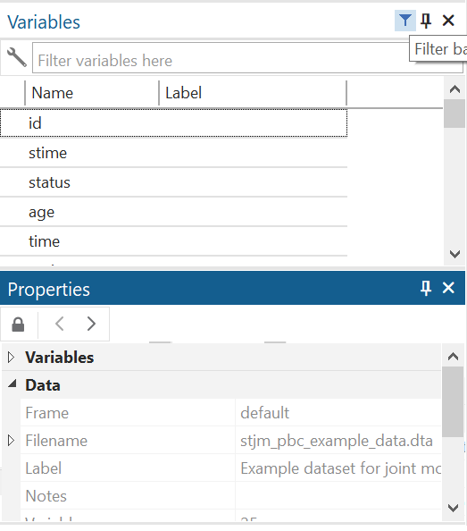
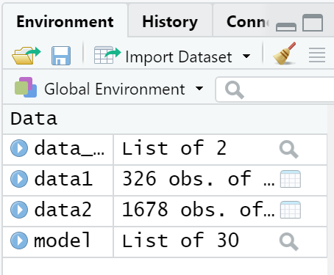
Comparison between Stata and R

Slide 5
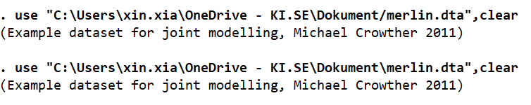
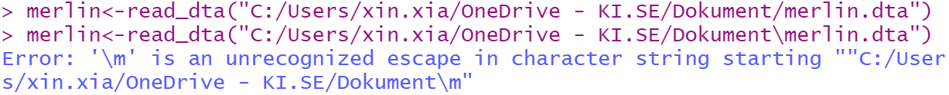
Comparison between Stata and R

Slide 6
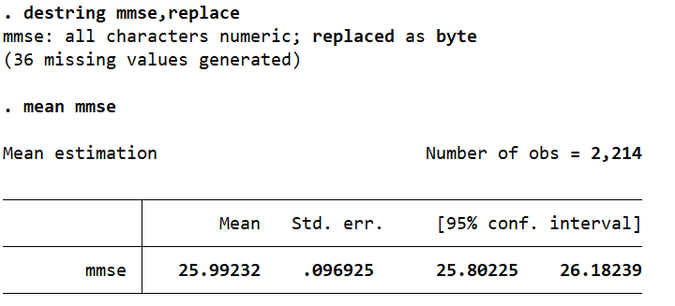
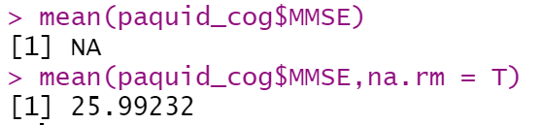
Comparison between Stata and R

Slide 7
Comparison between Stata and R packages-growth models
 | Stata | R
Linear mixed models | mixed, meglm, predict, margins (official commands, convenient for average adjusted predictions) | nlme, lme4, predict (convenient for out-of-sample predictions)
Latent class models | traj (user-written, data format: wide format, latent class growth models) | Lcmm (data format: long format, latent class growth models, growth mixture models, etc)
Note: There are more packages than those mentioned

Slide 8
Comparison between Stata and R packages-survival models
 | Stata | R
Semi-parametric models | stcox | survival
Parametric models | streg, stpm2 (user-written, useful postestimation commands: standardised survival curves, etc) | survival, flexsurv
Competing risk | Stcrreg (straightforward programming) | cmprsk
Note: There are more packages than those mentioned

Slide 9
Comparison between Stata and R packages-joint model of longitudinal and survival data
 | Stata | R
Shared-parameters | stjm, merlin | JMbayes2
Latent class | - | lcmm
Longitudinal data
Random effects/
latent process
Survival data

Slide 10
Considerations when choosing Stata or R
Choose the one that can suffice the task in the easiest way.
Examples:
Use Stata for simple regression models
Use R when the task involves multiple datasets

Slide 11
Tips for learning R
Don’t be scared
Don’t give up
Be mindful of the details-small mistakes bring frustrations
Read the warning messages
Google is your best teacher

Slide 12
Useful websites for learning R
R basics:
http://www.sthda.com/english/wiki/r-basics-quick-and-easy
https://www.coursera.org/learn/r-programming
Data visualization:
http://www.sthda.com/english/wiki/data-visualization
https://nbisweden.github.io/workshop-plotting-in-r/2109/index.html

Slide 13
Objects in R

Slide 14
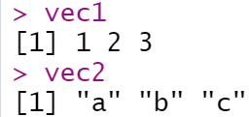
Objects in R-vector
vec1<-c(1,2,3)
vec2<-c("a","b","c")

Slide 15
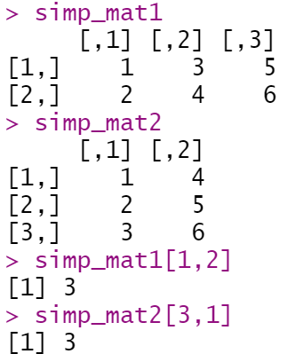
Objects in R-matrix
simp_mat1<-matrix(c(1:6),nrow=2,ncol=3)
simp_mat2<-matrix(c(1:6),nrow=3,ncol=2)

Slide 16
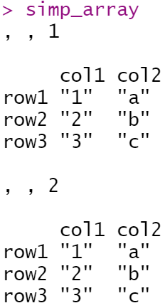
Objects in R-array
simp_array<-array(c(vec1,vec2),dim = c(3,2,2),
dimnames = list(c("row1","row2","row3"),
c("col1","col2")))

Slide 17
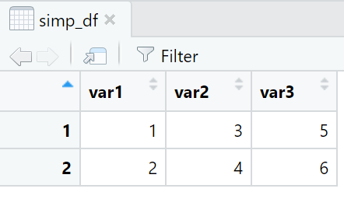
Objects in R-data frame
simp_df<-as.data.frame(matrix(c(1:6),nrow=2,ncol=3))
colnames(simp_df)<-c("var1","var2","var3")

Slide 18
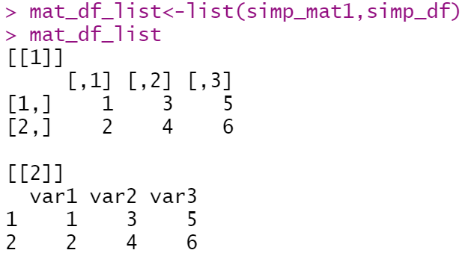
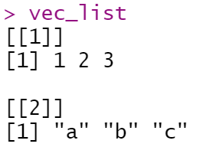
Objects in R-list
vec_list<-list(vec1,vec2)
mat_df_list<-list(simp_mat1,simp_df)

Slide 19
practice

